Slide 1

Exploring Airbnb
Property Rentals Case Study
September 10, 2024
UCW BUSI-650 - Summer24-12 Business Analytics
Prepared by Group 1

Slide 2

Team Members
Stacy Ferguson
Chikeluba Chijioke Iluno
Lucia Ceron Gomez
Group Lead
Chief Editor
Strategic Data Analyst

Slide 3
Team Members
Alexandra Quesada
Praise Favour Usman
Navneet Kaur
Analyst
Business Advisor
Writer

Slide 4
Introduction
Our project aims to analyze the performance of the Airbnb rentals in New York City’s 5 boroughs, to determine growth opportunities for our client. We explore the dynamics of new entrants and recommendations for maximizing income. We explore factors to be considered when setting price, other than location. Is Airbnb still a profitable business for homeowners?

Slide 5
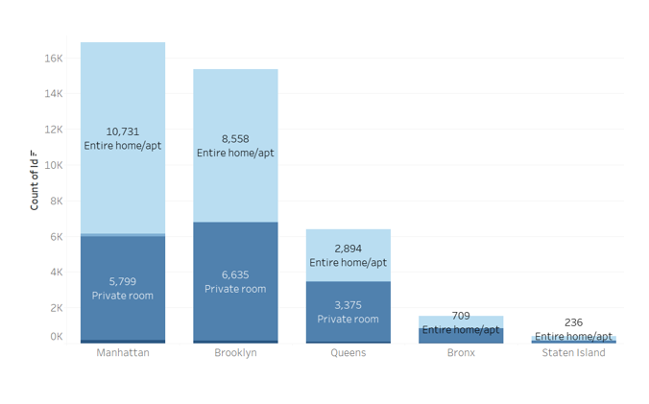
Airbnb in The City of Dreams
The City of Dreams of dreams welcomes 62 million tourists annually. Airbnb provides accommodation alternatives to suit every budget. We breakdown the options below across New York’s 5 boroughs
Manhattan - 17k rentals; 64% entire home, 34% private rooms
Brooklyn - 15k rentals; 56% entire homes, 43% private rooms
Queens - 6.3k rentals; 45% entire homes, 53% private rooms
Bronx & Staten Island - 1.7k rentals combined just under 50% are private rooms.

Slide 6
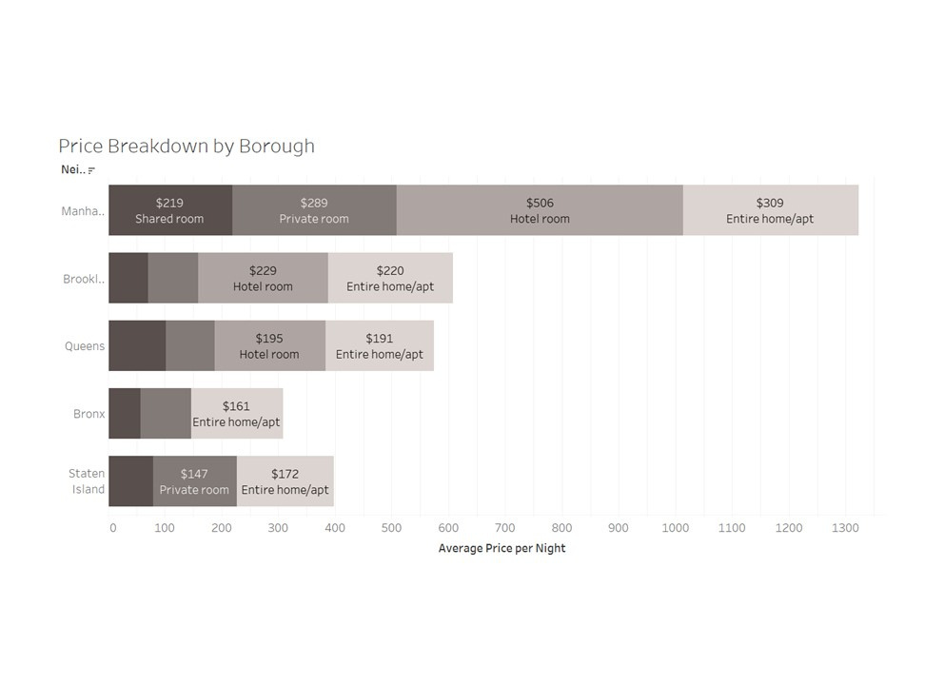
Rental Options
Rental Prices by Borough
Manhattan leads with highest number of rentals from $210 - $506
Brooklyn offers options starting at $70 for a shared room up to $220 for an entire home
Queens offers pricing options from as low as $119 to $191
Bronx offers competitive pricing at lows of $57 to $161
Staten Island’s lowest price points are $79 to $172 for sub-urban rental options

Slide 7
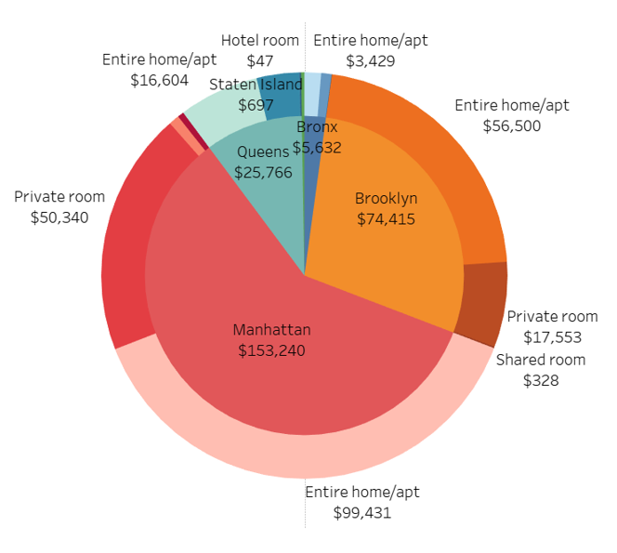
Airbnb’s Earnings
Commission Structure
Airbnb earns a commission of 3% per night from each host’s rental income.
Data shows at full occupancy Airbnb earns $260k per night
Manhattan Insights
Huge rental market - $153k nightly income
Popular sites - Broadway, Central Park, Empire State Building, & Times Square
Caters to a diverse target audience
Brooklyn Insights
Brooklyn contributes 29% or $74k of overall earnings.
Entire homes and private rooms are also key revenue drivers.
Top amenities - Brooklyn Bridge, Coney Island and Prospect Park

Slide 8
Airbnb’s Earnings
Queens Insights
Diverse range of listing options
Suitable for budget renters
Queens rentals contributed $25k in commissions for Airbnb
Bronx Insights
A small market - limited rentals
Amenities include Yankee Stadium and Bronx Zoo
Commission contributions are over $5000 per night
Staten Island Insights
Very few options rental options
Suited for travelers who want a quiet suburban alternative.
Low commissions - $2k per night in earnings for Airbnb

Slide 9
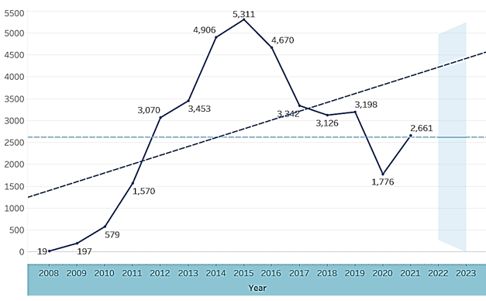
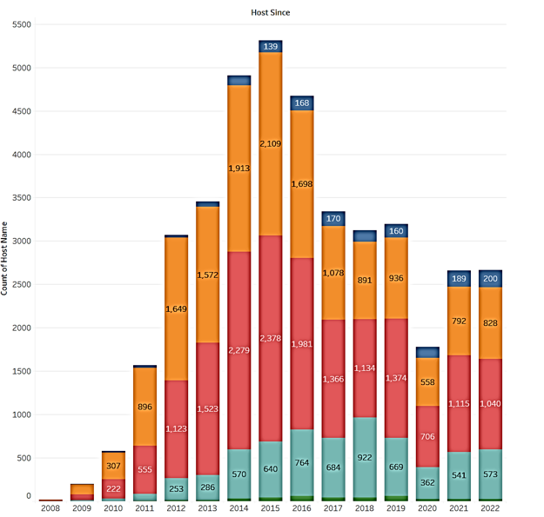
Annual New Entrant Growth
Our analysis shows peak growth in new entrants to NYC Airbnb market in 2015. Lowest growth year was 2020, likely a result of the pandemic and significant impact on the state. Data shows highest and lowest growth areas.

Slide 10
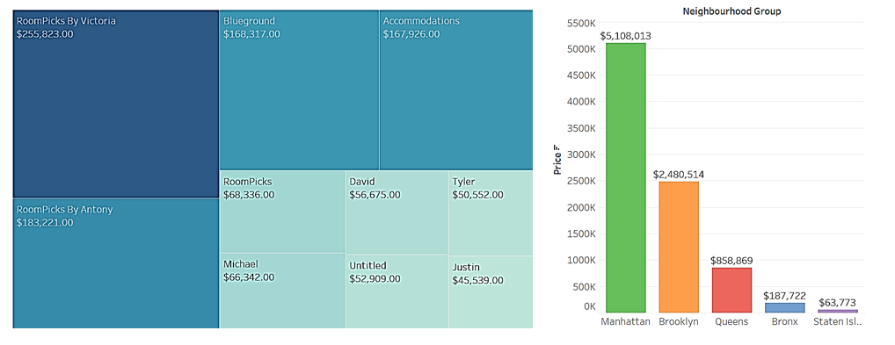
Host Earnings
For the savvy host who can predict the needs and wants of travelers, becoming a host can be very profitable. Some hosts are individuals, while others form a corporation with multiple rentals. Manhattan dominates with Top 10 hosts.

Slide 11
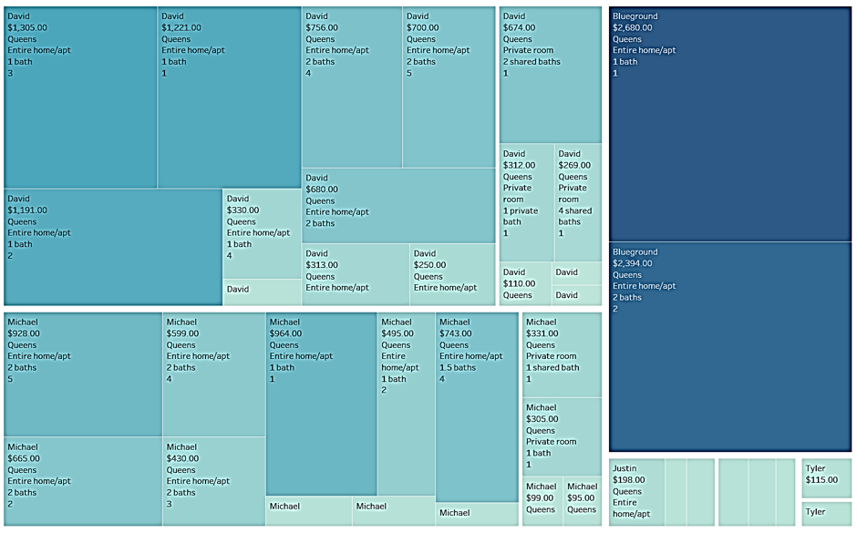
Host Earnings in Queens
The data shows several hosts have multiple listing in the Queens rental market,. This indicates high earnings are possible and there is still room for growth in the segment.

Slide 12



Factors Impacting Price
Host Reputation
Access to Transportation
Amenities
Airbnb reviews are shown to significantly impact a guest decision
Super hosts enjoy higher occupancy, increase bookings and creditbility
Pool, parking, cable, Wi-Fi allows hosts to charge more
Some hosts offer airport transfer value added services for higher rates
Rentals near airports and subway stations were found to be higher priced
Travelers explore cheaper rentals and commute if transit is reliable

Slide 13
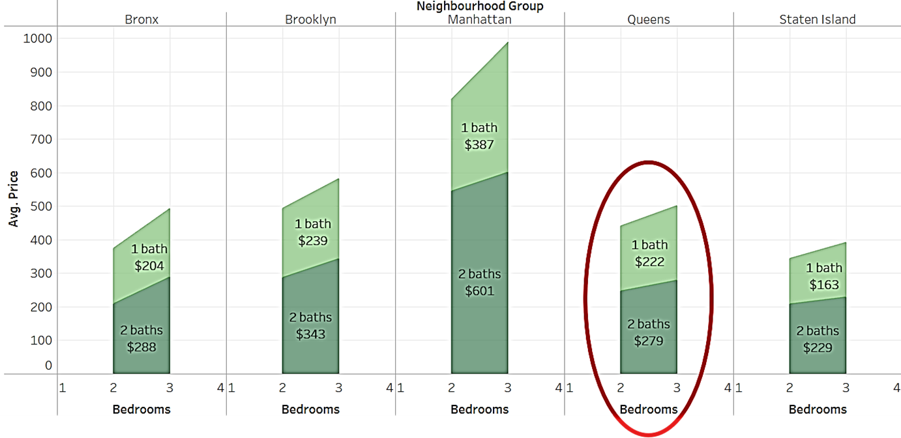
Pricing Strategy
Queens Airbnb rental market is competitively priced. The client will need to select a pricing strategy their goal.

Slide 14
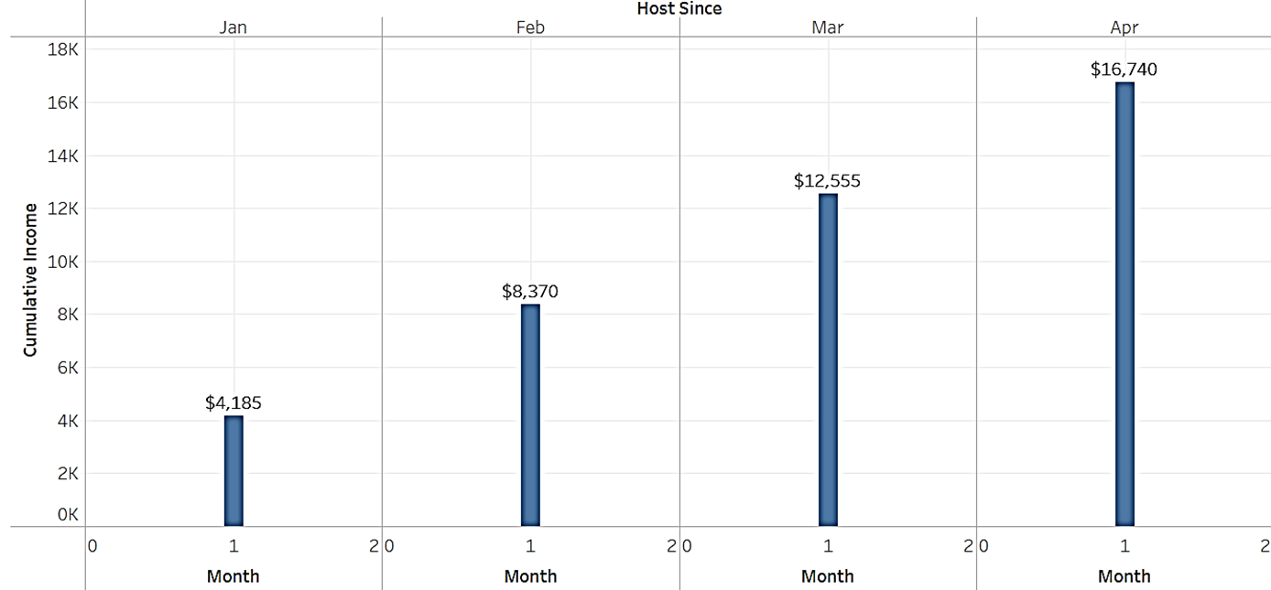
Recouping Investment at 50% Occupancy
Our analysis assumes conservative earnings given competitive market. First, we examine recovery period at 50% occupancy level monthly or 15 nights at full price of $279 per night

Slide 15
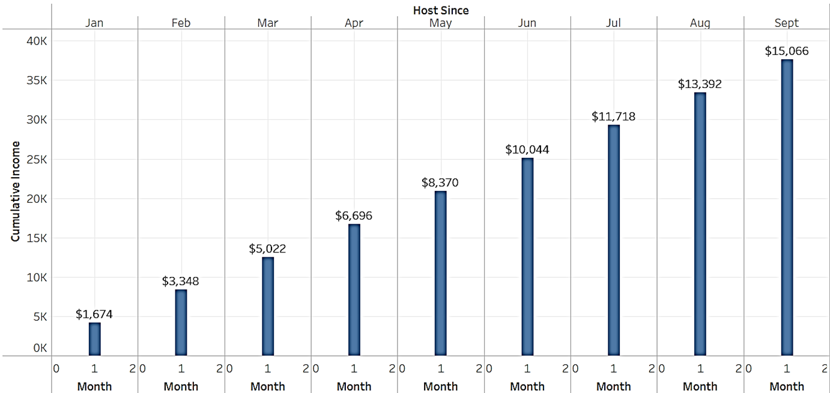
Recouping Investment at 20% Occupancy
A more conservative assumption is 20% occupancy level monthly or 6 nights at full price of $279 per night

Slide 16
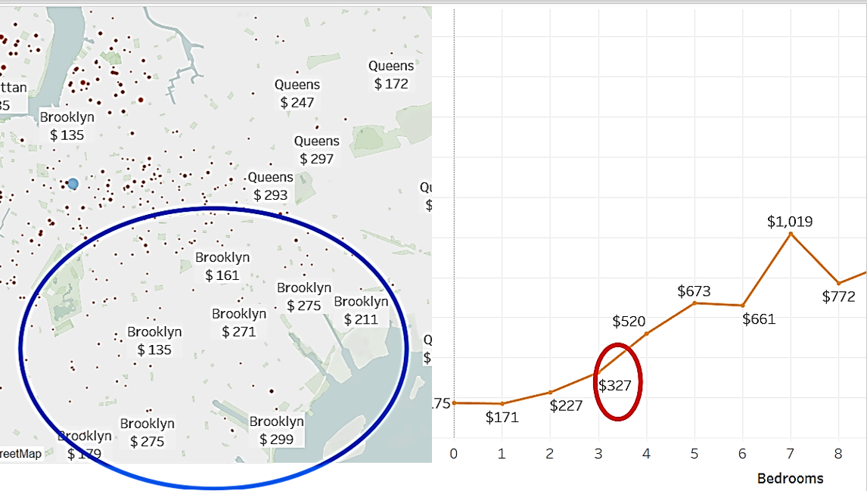
Average Pricing in Competitive Zone - Brooklyn
South of Queens is Brooklyn. Data shows comparable rentals in Brooklyn are around $327 per night

Slide 17
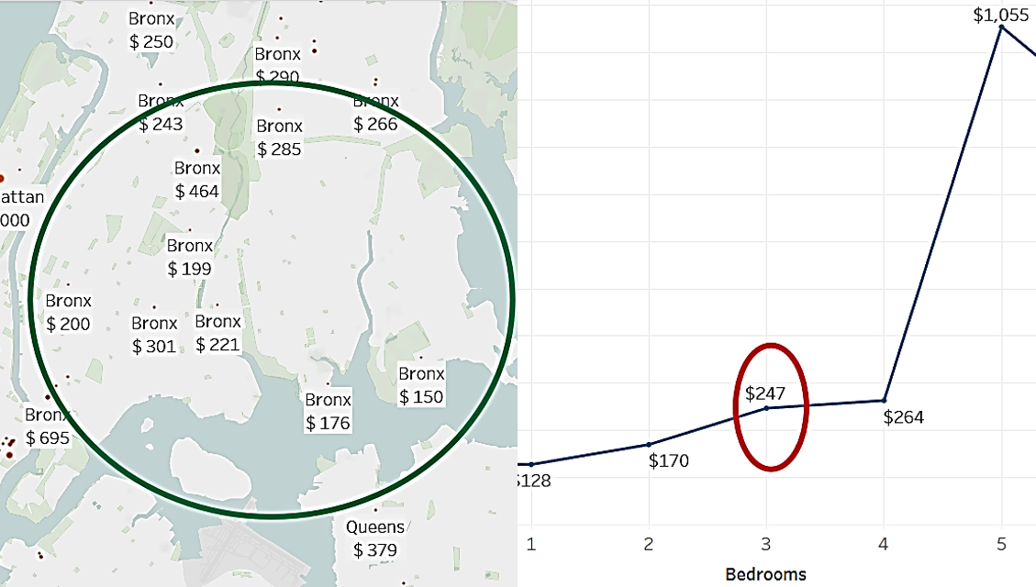
Average Pricing in Competitive Zone - Bronx
North of Queens is the Bronx. Data shows comparable rentals in Bronx are around $247 per night

Slide 18

Recommendations
Competitive Pricing
Price below or at market average to start
Research the market and offer amenities that are popular with higher rental units
Professional Photography
Consider engaging a designer to chose timeless, on trend color pallets and modern/contemporary designs
Invest in high quality, professional photography to emphasize the cleanliness of the unit and elevated decor
Target Marketing & Customer Experience
Cater to families, business travelers or groups
Partner with tour companies, restaurant or business to offer promotional pricing to their patrons
Prioritize guest experience. Ensure check in and out processes are seamless. A responsive host enjoys great reviews

Slide 19
Conclusion
There are still many opportunities for growth in the Queens Airbnb rental market. We recommend the client approaches the investment with a view to enter the market with premium amenities and flexible booking/cancellation policies to attract a broad target audience. Leverage social media and use SEO to promote the property for best results.

Slide 20
Q & A

Slide 21
Thank you

